Slide 1
Storage
Parker Zhou
parkerzho2010@gmail.com

Slide 2
Topic
Cookie
LocalStorage
Basic use
Events
SessionStorage
Introduction of Web SQL
Introduction of IndexedDB

Slide 3
Cookie
A piece of message stored in the browser
Size limitation(4KB)
Every cookie is sent with each HTTP request/response, regardless of whether the values are needed

Slide 4
LocalStorage
setItem(key, value) Method that stores a value by using the associated key
localStorage.setItem('firstName', $('#firstName').val());
localStorage['firstName'] = $('#firstName').val();
localStorage.firstName = $('#firstName').val();

Slide 5
LocalStorage
getItem(key) Method of retrieving a value by using the associated key
removeItem(key) Method to remove a value from localStorage by using the associated key.
var firstName = localStorage.getItem('firstName');
var firstName = localStorage['firstName'];
var firstName = localStorage.firstName;
localStorage.removeItem('firstName');

Slide 6
LocalStorage
The localStorage object provides much more space. Modern browsers support a minimum of 5 MB of data

Slide 7
LocalStorage
Storing complex objects
var person = { firstName: 'Glenn', lastName: 'Johnson' };
localStorage.setItem('glenn', JSON.stringify(person));
var person = JSON.parse(localStorage.getItem('glenn'));

Slide 8
LocalStorage
Subscribing to events
function respondToChange(e) {
alert(e.newValue);
}
window.addEventListener('storage', respondToChange);
//trigger
localStorage.setItem('name', 'Glenn');
Notes:
The event must across the window in chrome

Slide 9
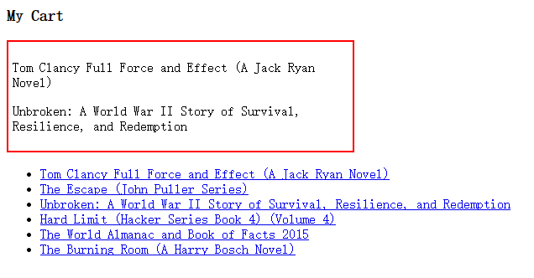
Exercise
Notes:
<!DOCTYPE html>
<html>
<head>
<script src="http://cdn.bootcss.com/jquery/2.1.1/jquery.min.js"></script>
<style type="text/css">
#cart{
width: 400px;
border: 2px solid #f00;
padding: 5px;
}
</style>
</head>
<body>
<h3>My Cart</h3>
<div id="cart">
</div>
<ul id="books">
<li><a href="##">Tom Clancy Full Force and Effect (A Jack Ryan Novel)</a></li>
<li><a href="##">The Escape (John Puller Series)</a></li>
<li><a href="##">Unbroken: A World War II Story of Survival, Resilience, and Redemption</a></li>
<li><a href="##">Hard Limit (Hacker Series Book 4) (Volume 4)</a></li>
<li><a href="##">The World Almanac and Book of Facts 2015</a></li>
<li><a href="##">The Burning Room (A Harry Bosch Novel)</a></li>
</ul>
<script type="text/javascript">
function getCartData(){
var cd = window.localStorage.getItem('cart_data');
if(!cd){
return;
}
var parsed_cd = JSON.parse(cd);
if($.isArray(parsed_cd)){
return parsed_cd;
}
}
function renderCart(e){
if(e.key == 'cart_data'){
var cd = JSON.parse(e.newValue);
$('#cart').empty();
cd.forEach(function(item){
$('#cart').append('<p>' + item + '</p>')
})
}
}
var cart_data = [];
window.localStorage.setItem('cart_data',JSON.stringify(cart_data));
window.addEventListener('storage',renderCart,false);
$('#books').on('click','li a',function (e) {
var parsed_cd = getCartData();
if(!parsed_cd) return;
var $this = $(this);
parsed_cd.push($this.text());
window.localStorage.setItem('cart_data',JSON.stringify(parsed_cd));
e.preventDefault();
e.stopPropagation();
})
</script>
</body>
</html>

Slide 10
SessionStorage
Almost same as LocalStorage
LocalStorage is designed to retain data across multiple sessions
SessionStorage retains data for a single session only. After the user closes the browser window, records stored are automatically. Its data cannot be passed from one tab to the next

Slide 11
Web SQL
It provides a full relational database that includes many of the features you’ve come to enjoy from the server-side database offerings
Most current implementations are built on SQLite, which is one of the most widely used lightweight database engines
Only `webkit` browser support(Safari,Chrome)
Notes:
In 2010, the W3C Web Applications Working Group announced that it does not intend to maintain the specification

Slide 12
Web SQL
var db = openDatabase('Library', '2.0', 'My library', 5 * 1024 * 1024);
db.transaction(function(t){
t.executeSql("INSERT INTO authors(firstName, lastName) " + " VALUES('Daniel', 'Defoe')");
});
function displayResults(transaction, results) {
for (var i = 0; i < results.rows.length; i++) {
var item = results.rows.item(i);
$('#items').append('<li>' + item.firstName + " " + item.lastName + '</li>');
}
}
var db = openDatabase('Library', '2.0', 'My library', 5 * 1024 * 1024);
db.transaction(function(t){
t.executeSql("SELECT * FROM authors", [], displayResults)
});
Notes:
In 2010, the W3C Web Applications Working Group announced that it does not intend to maintain the specification

Slide 13
IndexedDB
It’s a key/value database in which values can range from simple strings to complex object structures(NO-SQL)

Slide 14
IndexedDB
database1(name,version)
object store(name,key..,index1,index2,index3…)
{id:1,name:,age:,email…}
{id:2,name:,age:,email…}
{id:3,name:,age:,email…}
object store…
…
database2(name,version)
…

Slide 15
IndexedDB
window.indexedDB = window.indexedDB || window.mozIndexedDB || window.webkitIndexedDB || window.msIndexedDB;
window.IDBTransaction = window.IDBTransaction || window.webkitIDBTransaction;
window.IDBCursor = window.IDBCursor || window.webkitIDBCursor;
window.IDBKeyRange = window.IDBKeyRange || window.webkitIDBKeyRange;
Notes:
Using browser-specific code

Slide 16
IndexedDB
Versioning
Index
Transaction
Cursor
KeyRange
Notes:
Use exmple to explain this

Slide 17
File System API
By using the FileSystem API, you can create directories and files within a sandboxed location on the user’s file system, and this opens the door to a number of new capabilities that were previously limited to desktop applications
Only be supported by chrome

Slide 18
Exercise
Create a web application that can maintain a “books” table(add,update,remove,fetch books)
Using IndexedDB
Several pages and styled UI
Notes:
Use exmple to explain this

